Slide 1
ETERNITY Calculator Team F
Justin Castonguay, Daniel Fakhr, Jaime Andres Hernandez,
Daniel Thibault-Shea, Ashkhan Yaghmar

Slide 2
Requirements gathering
Team discussion
Market research
Interviews

Slide 3
Personas
2 broad categories
Mathematical users
Casual users

Slide 4
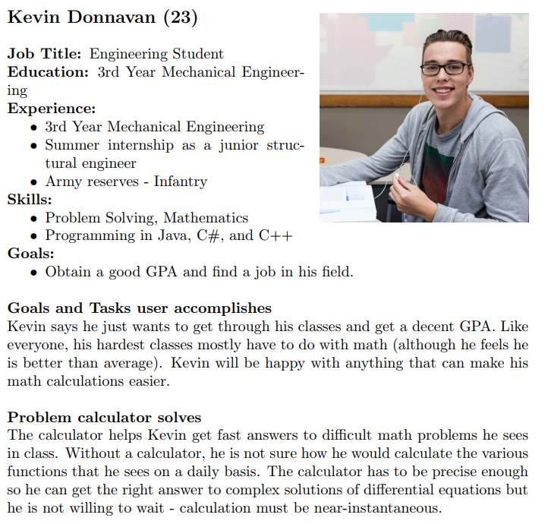
Mathematical user
Needs :
J
J
J
Would like :
J
J
j

Slide 5
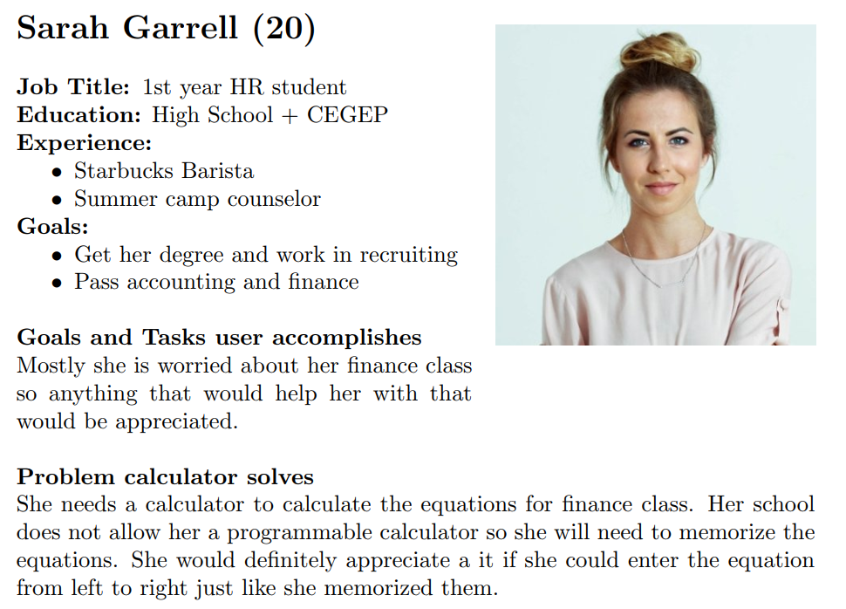
Casual user
Needs :
J
J
J
Would like :
J
J
j

Slide 6
Interview summaries
Simplicity
Physical calculators -> GUI could look like physical calculator
Hot keys
Simple functions (plus, minus, etc.)
Portability
Customizable (physical and software wise) → download functions
Calculator will need to be simple, customizable, and reliable.

Slide 7
Technologies
Java
GUI JavaFX
Non-distributed
JUnit testing

Slide 8
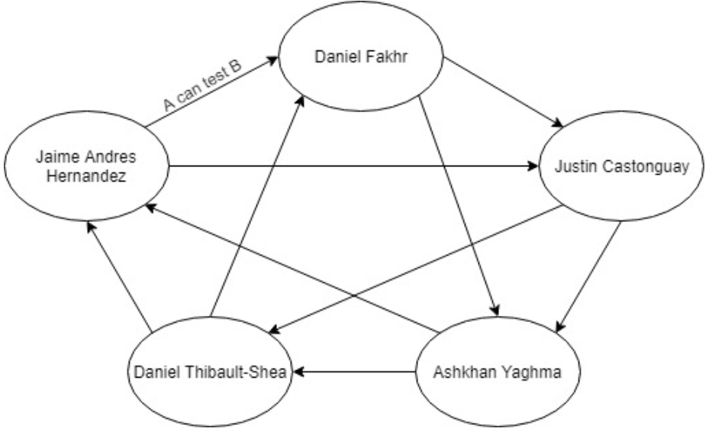
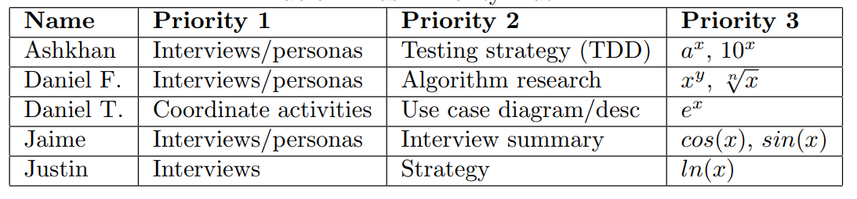
Team organization
Collaboration patterns
Decision-making process
Mutual support structure

